Slide 1

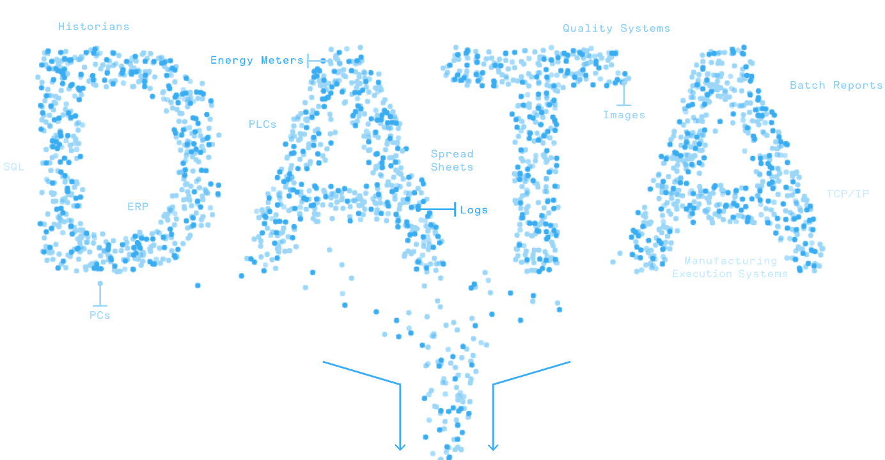
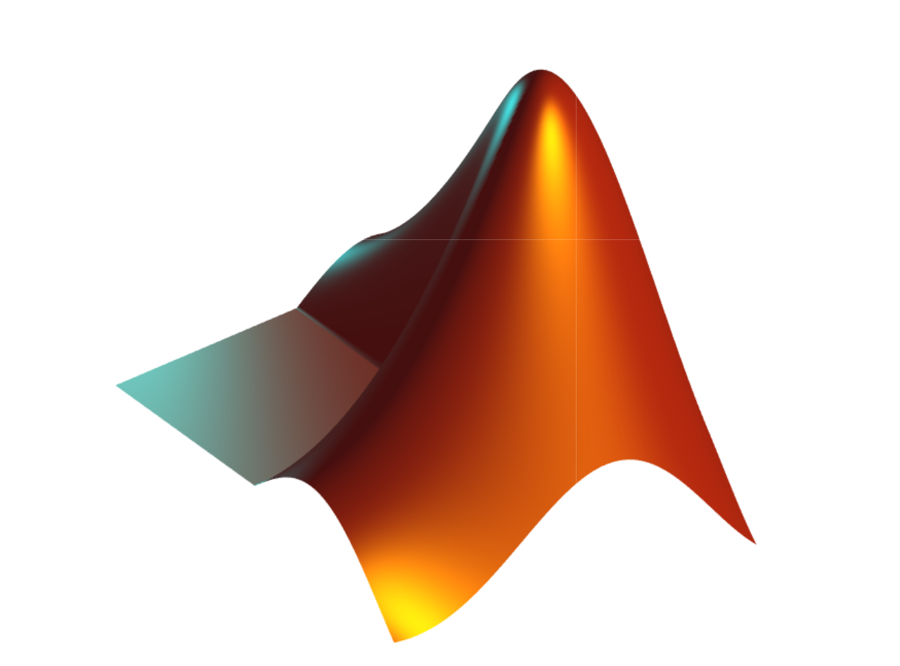

MATLAB Fundamental Laboratory Handbook (MATLAB)
Chapter 13 MatLab Robotics Toolbox
1

Slide 2
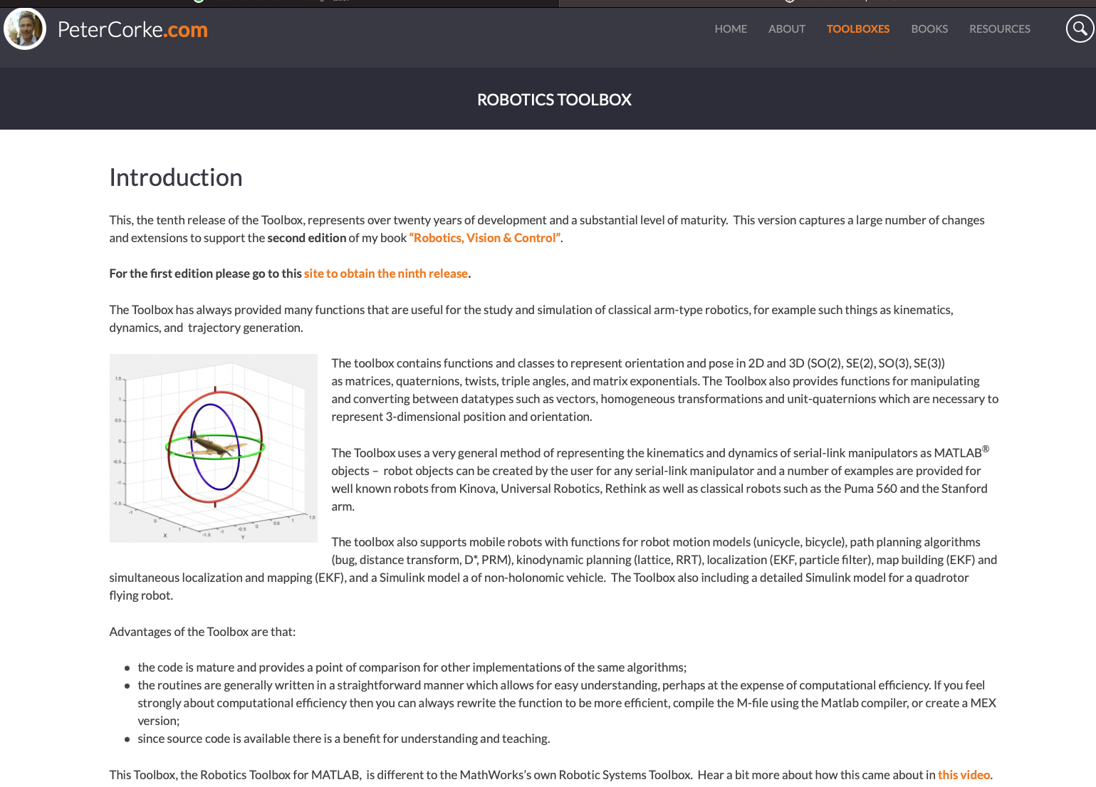
MatLab Robotics Toolbox
https://petercorke.com/toolboxes/robotics-toolbox/

Slide 3
MatLab Robotics Toolbox
How to download and install?
https://petercorke.com/download/27/rtb/1045/rtb10-4-mltbx.mltbx
(Also available in your learningmall)
Drag it into the MatLab, then, install it.

Slide 4
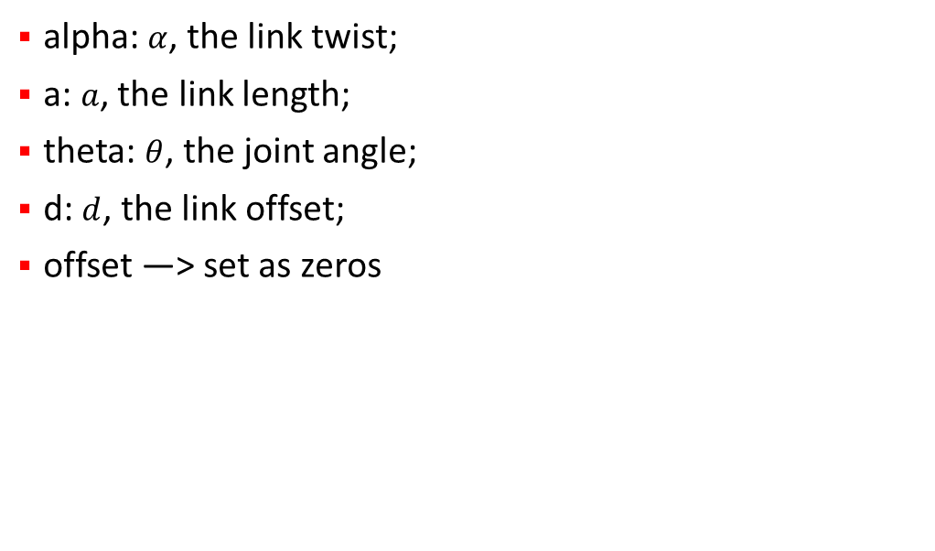
MatLab Robotics Toolbox
Parameters
alpha: $α$, the link twist;
a: $a$, the link length;
theta: $θ$, the joint angle;
d: $d$, the link offset;
offset —> set as zeros

Slide 5
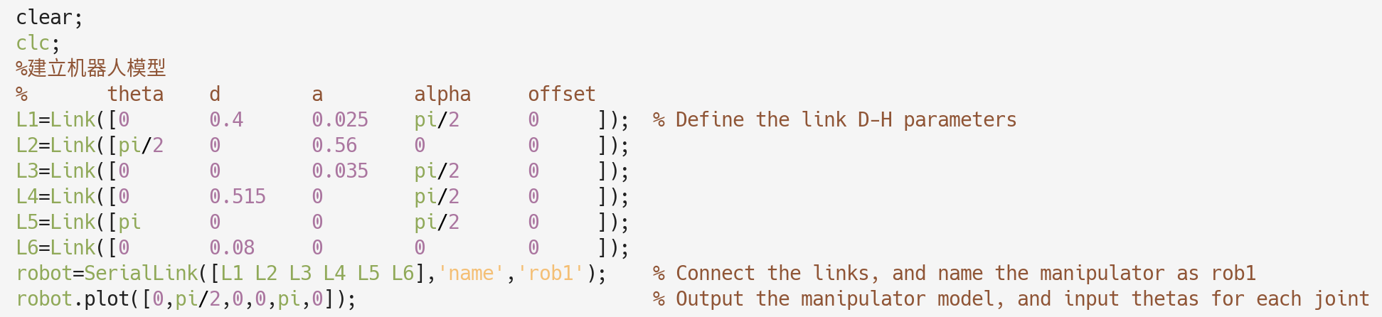
MatLab Robotics Toolbox
Building the robotics model

Slide 6
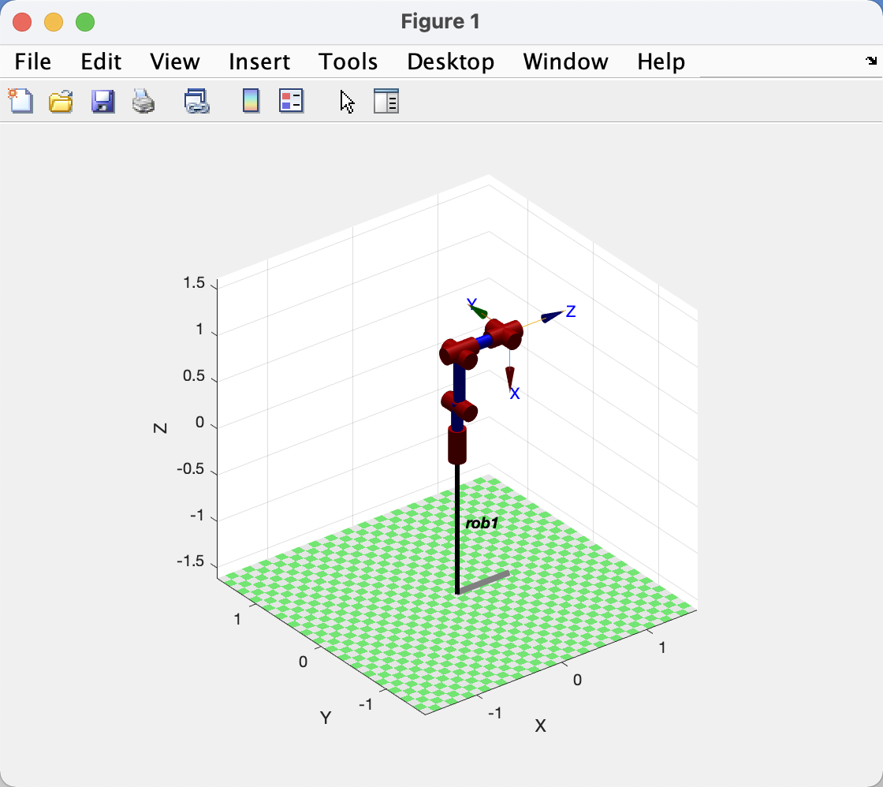
MatLab Robotics Toolbox
Building the robotics model
Please try other possible values.

Slide 7
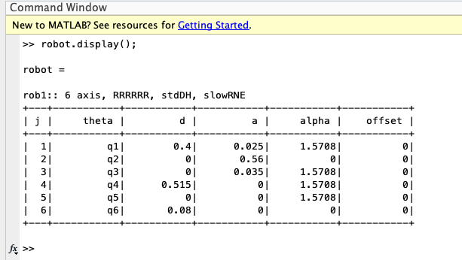
MatLab Robotics Toolbox
Display robotics parameters
It gives the model parameters

Slide 8
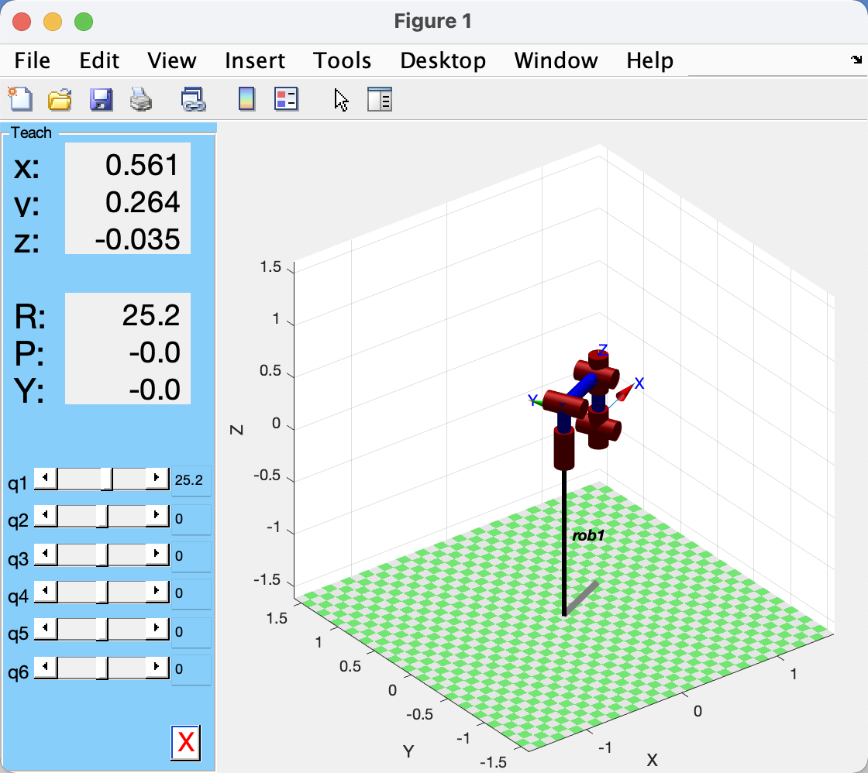
MatLab Robotics Toolbox
Play the robot
teach(robot);
Enable adjusting joint angels

Slide 9
MatLab Robotics Toolbox
Forward and Inverse Kinematics
What is the forward and inverse kinematics?

Slide 10
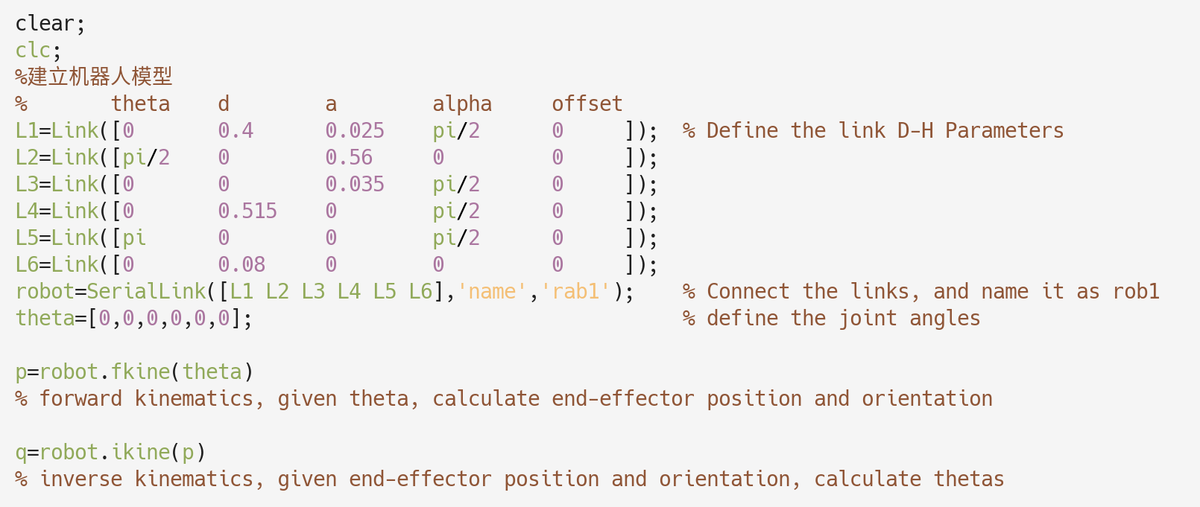
MatLab Robotics Toolbox
Forward and Inverse Kinematics

Slide 11
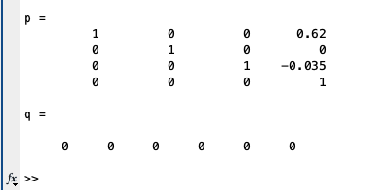
MatLab Robotics Toolbox
Forward and Inverse Kinematics
Please try other possible values.

Slide 12
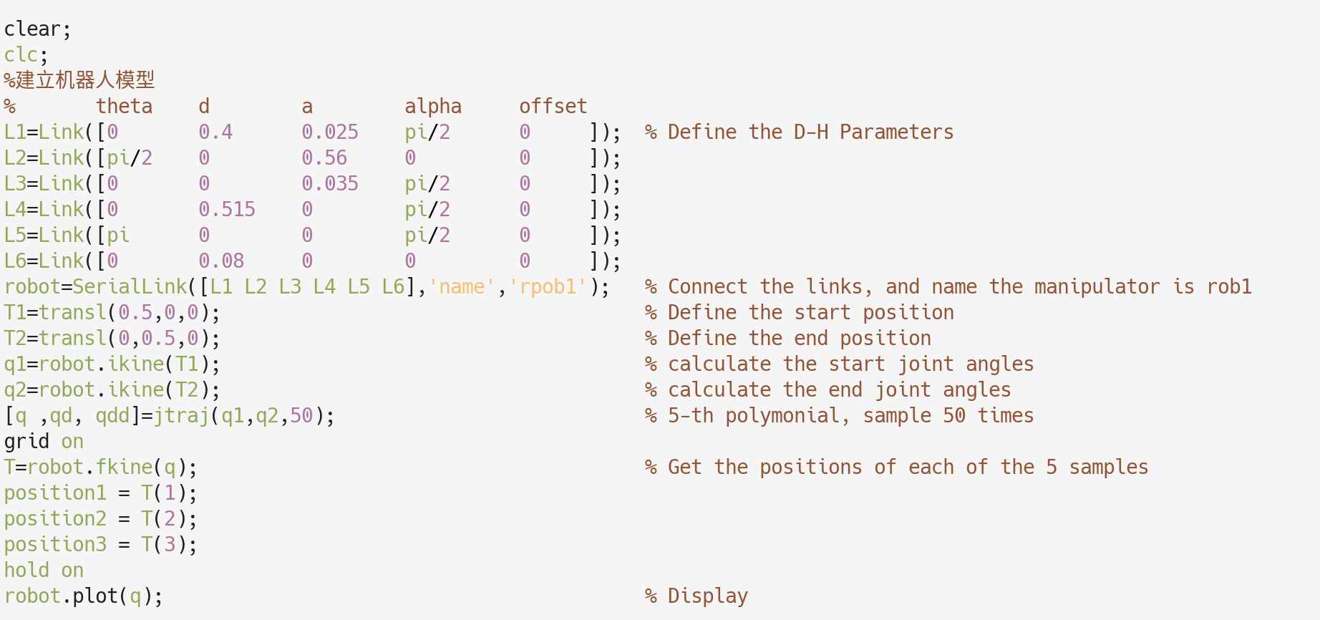
MatLab Robotics Toolbox
Trajectory Planning
In practice, we make use of the start + end positions to plan the trajectory.

Slide 13
MatLab Robotics Toolbox
Trajectory Planning
In practice, we make use of the start + end positions to plan the trajectory.

Slide 14
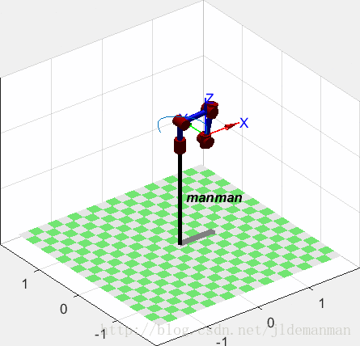
MatLab Robotics Toolbox
Trajectory Planning

